Slide 1

PHP Object Oriented Programming (OOP)

Slide 2
PHP => Object Oriented
With PHP 5 and above, an object oriented approach is the preferred pattern.
Libraries are evolving toward OOP.

Slide 3
Intro to OOP
OOP stands for object oriented programming.
The basic idea of OOP is that we use objects to model real world things that we want to represent inside our programs, as shown previously with the example of a car.
Objects can contain related data and code, which represent information about the thing you are trying to model, and functionality or behavior that you want it to have.

Slide 4
Intro to OOP
Object data (and often, functions too) can be stored neatly (the official word is encapsulated) inside an object package (which can be given a specific name to refer to, which is sometimes called a namespace), making it easy to structure and access.
Let's consider a simple program that displays information about the students and teachers at a school. Here we'll first look at OOP theory in general, not in the context of any specific programming language.
There are lots of things you could know about a person (their address, height, shoe size, DNA profile, passport number, significant personality traits ...) , but in this case we are only interested in showing their name, age, gender, and interests.

Slide 5
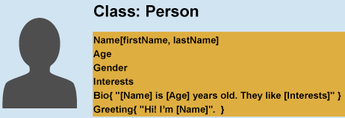
Intro to OOP
And we also want to be able to write a short introduction about them based on this data, and get them to say hello.
This is known as abstraction — creating a simple model of a more complex thing, which represents its most important aspects in a way that is easy to work with for our program's purposes.

Slide 6
Intro to OOP
From our class, we can create object instances — objects that contain the data and functionality defined in the class.
From our Person class, we can now create some actual people:

Slide 7
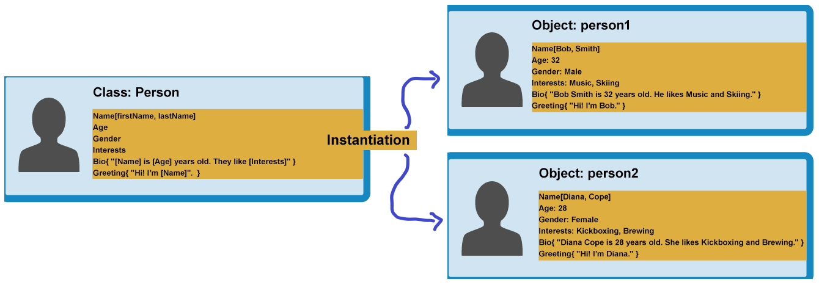
Intro to OOP
As shown -

Slide 8
Intro to OOP
When an object instance is created from a class, the class's constructor function is run to create it.
This process of creating an object instance from a class is called instantiation — the object instance is instantiated from the class.

Slide 9
Intro to OOP
Now we may not want generic people — we want teachers and students, which are both more specific types of people.
In OOP, we can create new classes based on other classes — these new child classes (also known as subclasses) can be made to inherit the data and code features of their parent class, so you can reuse functionality common to all the object types rather than having to duplicate it.
Where functionality differs between classes, you can define specialized features directly on them as needed.

Slide 10
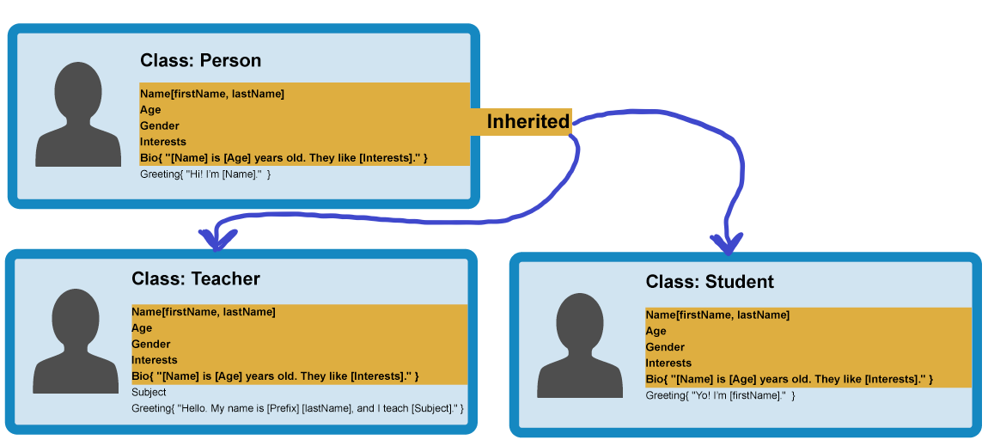
Intro to OOP

Slide 11
Intro to OOP
This is really useful — teachers and students share many common features such as name, gender, and age, so it is convenient to only have to define those features once.
You can also define the same feature separately in different classes, as each definition of that feature will be in a different namespace.
For example, a student's greeting might be of the form "Yo, I'm [firstName]" (e.g Yo, I'm Sam), whereas a teacher might use something more formal, such as "Hello, my name is [Prefix] [lastName], and I teach [Subject]." (e.g Hello, My name is Mr Griffiths, and I teach Chemistry).

Slide 12
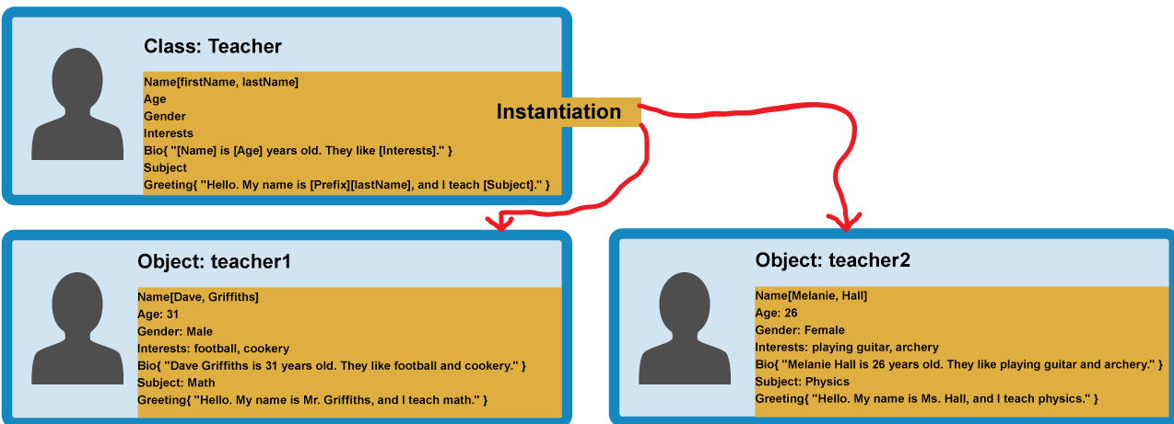
Intro to OOP
You can now create object instances from your child classes. For example:

Slide 13
Object Oriented Programming (OOP)
Object-oriented programming (OOP) is a programming paradigm that represents concepts as "objects" that have data fields (attributes that describe the object) and associated procedures known as methods. Objects, which are usually instances of classes, are used to interact with one another to design applications and computer programs.
http://en.wikipedia.org/wiki/Object-oriented_programming

Slide 14
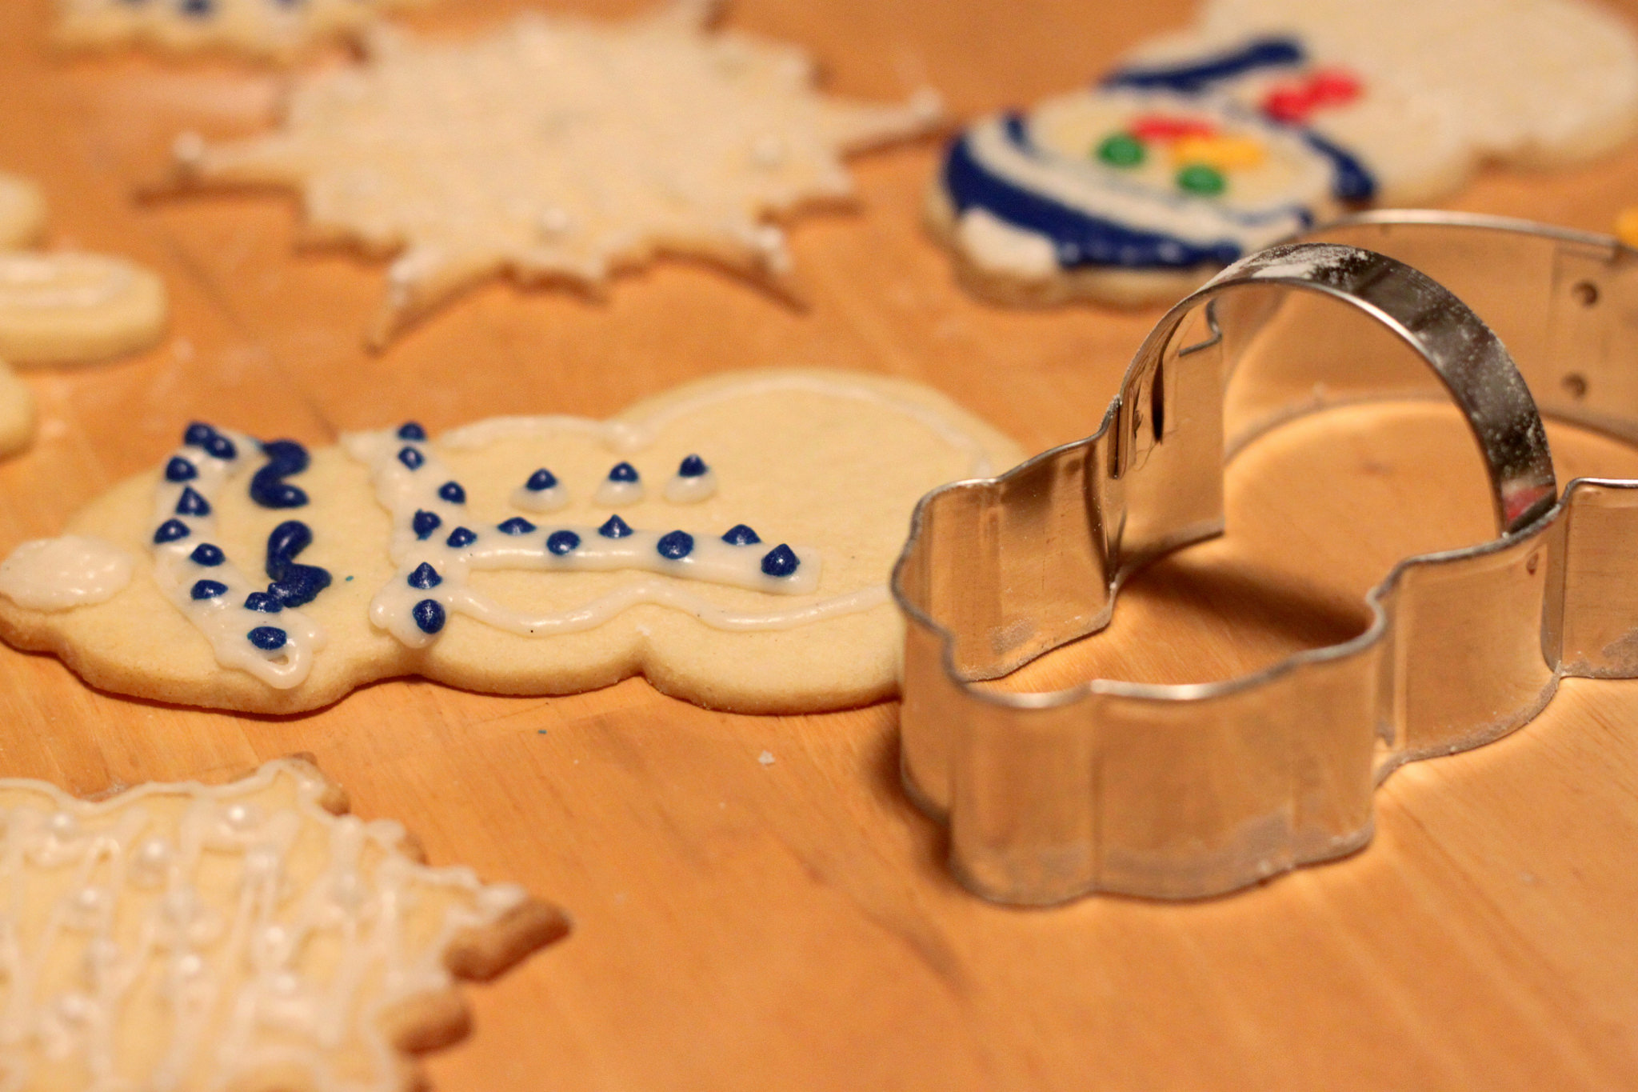
Definitions
Class - a template - Dog
Method - A defined capability of a class - bark()
Object or Instance - A particular instance of a class - Lassie
Image CC-By 2.0: https://www.flickr.com/photos/dinnerseries/23570475099

Slide 15
Terminology: Class
Defines the abstract characteristics of a thing (object), including the thing’s characteristics (its attributes, fields, or properties) and the thing’s behaviors (the things it can do, or methods, operations, or features). One might say that a class is a blueprint or factory that describes the nature of something. For example, the class Dog would consist of traits shared by all dogs, such as breed and fur color (characteristics), and the ability to bark and sit (behaviors).

Slide 16
Terminology: Instance
One can have an instance of a class or a particular object. The instance is the actual object created at runtime. In programmer jargon, the Lassie object is an instance of the Dog class. The set of values of the attributes of a particular object is called its state. The object consists of state and the behavior that is defined in the object’s class.
Object and Instance are often used interchangeably.

Slide 17
Terminology: Method
An object’s abilities. In language, methods are verbs. Lassie, being a Dog, has the ability to bark. So bark() is one of Lassie’s methods. She may have other methods as well, for example sit() or eat() or walk() or save_timmy(). Within the program, using a method usually affects only one particular object; all Dogs can bark, but you need only one particular dog to do the barking.
Method and Message are often used interchangeably.

Slide 18
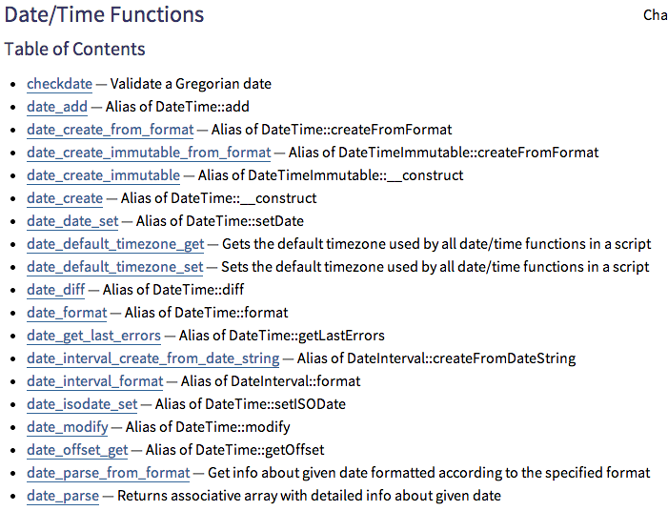
Non-OOP
http://php.net/manual/en/ref.datetime.php

Slide 19
<?php
date_default_timezone_set('America/New_York');
$nextWeek = time() + (7 * 24 * 60 * 60);
echo 'Now: '. date('Y-m-d') ."\n";
echo 'Next Week: '. date('Y-m-d', $nextWeek) ."\n";
echo("=====\n");
$now = new DateTime();
$nextWeek = new DateTime('today +1 week');
echo 'Now: '. $now->format('Y-m-d') ."\n";
echo 'Next Week: '. $nextWeek->format('Y-m-d') ."\n";
Now: 2013-09-25
Next Week: 2013-10-02
=====
Now: 2013-09-25
Next Week: 2013-10-02
date.php

Slide 20
Making a Class / Objects

Slide 21
nonobj.php
<?php
$chuck = array("fullname" => "Chuck Severance",
'room' => '4429NQ');
$colleen = array("familyname" => "van Lent",
'givenname' => 'Colleen', 'room' => '3439NQ');
function get_person_name($person) {
if ( isset($person['fullname']) ) return $person['fullname'];
if ( isset($person['familyname']) && isset($person['givenname']) ) {
return $person['givenname'] . ' ' . $person['familyname'] ;
}
return false;
}
print get_person_name($chuck) . "\n";
print get_person_name($colleen) . "\n";
Chuck Severance
Colleen van Lent

Slide 22
<?php
class Person {
public $fullname = false;
public $givenname = false;
public $familyname = false;
public $room = false;
function get_name() {
if ( $this->fullname !== false ) return $this->fullname;
if ( $this->familyname !== false && $this->givenname !== false ) {
return $this->givenname . ' ' . $this->familyname;
}
return false;
}
}
$chuck = new Person();
$chuck->fullname = "Chuck Severance";
$chuck->room = "4429NQ";
$colleen = new Person();
$colleen->familyname = 'van Lent';
$colleen->givenname = 'Colleen';
$colleen->room = '3439NQ';
print $chuck->get_name() . "\n";
print $colleen->get_name() . "\n";
withobj.php
Chuck Severance
Colleen van Lent

Slide 23
Object Life Cycle
http://en.wikipedia.org/wiki/Constructor_(computer_science)

Slide 24
Object Life Cycle
Objects are created, used and discarded.
We have special blocks of code (methods) that get called
- At the moment of creation (constructor)
- At the moment of destruction (destructor)
Constructors are used a lot.
Destructors are seldom used.

Slide 25
Constructor
The primary purpose of the constructor is to set up some instance variables to have the proper initial values when the object is created.

Slide 26
class PartyAnimal {
function __construct() {
echo("Constructed\n");
}
function something() {
echo("Something\n");
}
function __destruct() {
echo("Destructed\n");
}
}
echo("--One\n");
$x = new PartyAnimal();
echo("--Two\n");
$y = new PartyAnimal();
echo("--Three\n");
$x->something();
echo("--The End?\n");
party.php
--One
Constructed
--Two
Constructed
--Three
Something
--The End?
Destructed
Destructed

Slide 27
Many Instances
We can create lots of objects - the class is the template for the object.
We can store each distinct object in its own variable.
We call this having multiple instances of the same class.
Each instance has its own copy of the instance variables.

Slide 28
class Hello {
protected $lang; // Only accessible in the class
function __construct($lang) {
$this->lang = $lang;
}
function greet() {
if ( $this->lang == 'fr' ) return 'Bonjour';
if ( $this->lang == 'es' ) return 'Hola';
return 'Hello';
}
}
$hi = new Hello('es');
echo $hi->greet()."\n";
Hola
hello.php

Slide 29
Definitions
Class - a template - Dog
Method or Message - A defined capability of a class - bark()
Object or Instance - A particular instance of a class - Lassie
Constructor - A method which is called when the instance / object is created

Slide 30
Inheritance
http://www.php.net/manual/en/language.oop5.inheritance.php

Slide 31
Inheritance
When we make a new class we can reuse an existing class and inherit all the capabilities of an existing class and then add our own little bit to make our new class
Another form of store and reuse
Write once - reuse many times
The new class (child) has all the capabilities of the old class (parent) - and then some more

Slide 32
Terminology: Inheritance
“Subclasses” are more specialized versions of a class, which inherit attributes and behaviors from their parent classes, and can introduce their own.
http://en.wikipedia.org/wiki/Object-oriented_programming

Slide 33
goodbye.php
class Hello {
protected $lang;
function __construct($lang) { ... }
function greet() { ... }
}
class Social extends Hello {
function bye() {
if ( $this->lang == 'fr' ) return 'Au revoir';
if ( $this->lang == 'es' ) return 'Adios';
return 'goodbye';
}
}
$hi = new Social('es');
echo $hi->greet()."\n";
echo $hi->bye()."\n";
Hola
Adios

Slide 34
Definitions
Class - a template - Dog
Method or Message - A defined capability of a class - bark()
Object or Instance - A particular instance of a class - Lassie
Constructor - A method which is called when the instance / object is created
Inheritance - the ability to take a class and extend it to make a new class

Slide 35
Visibility
Class member variables also have scope.
Public – can be accessed outside the class, inside the class, and in derived classes
Protected – can be accessed inside the class, and in derived classes
Private – can only be accessed inside the class (i.e. private variables are not visible in derived classes)
http://www.php.net/manual/en/language.oop5.visibility.php

Slide 36
class MyClass
{
public $pub = 'Public';
protected $pro = 'Protected';
private $priv = 'Private';
function printHello()
{
echo $this->pub."\n";
echo $this->pro."\n";
echo $this->priv."\n";
}
}
$obj = new MyClass();
echo $obj->pub."\n"; // Works
echo $obj->pro."\n"; // Fatal Error
echo $obj->priv."\n"; // Fatal Error
$obj->printHello(); // Shows Public, Protected and Private
visibility.php
Public
Public
Protected
Private

Slide 37
class MyClass2 extends MyClass
{
function printHello()
{
echo $this->pub."\n";
echo $this->pro."\n";
echo $this->priv."\n"; // Undefined
}
}
echo("--- MyClass2 ---\n");
$obj2 = new MyClass2();
echo $obj2->pub."\n"; // Works
$obj2->printHello(); // Shows Public, Protected, Undefined
--- MyClass2 ---
Public
Public
Protected
(false)

Slide 38
Summary
Object Oriented programming is a very structured approach to code reuse.
There is a trend away from global function names and toward OO.
We can group data and functionality together and create many independent instances of a class.

Slide 39
Challenges

Slide 40
Challenges
We are gonna build a form input validation system.
The user will be provided with username, email, password, and confirm password fields.
When the user submits, his input will be validated. Any error will be displayed below the corresponding input field. If there aren’t any errors, then a success message will be displayed.
It is MANDATORY for you to use OOP here.

Slide 41
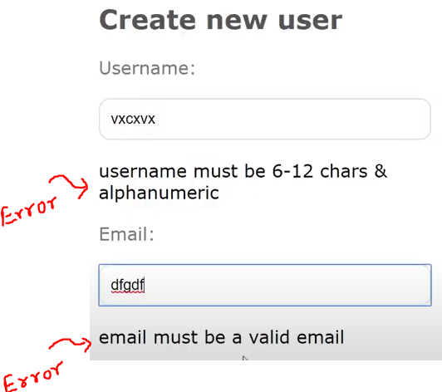
Challenges
Like this ->
When an error occurs, the old value that the user had input must still be in the input field.

Slide 42
Challenges
For valid input -
No field can be empty
email must be a valid email
username and password can’t be less than 6 characters.
password and confirm password fields must match
password must be a combination of at least one uppercase and lowercase letter, and a number.

Slide 43
Challenges
How to solve this problem using OOP-
Create a validator class to handle validation
Constructor which takes in POST data from the form
(Optional) Have an array that contains all the fields that the user must input. Use this array for generic validations like if any field is empty, or is not set, etc.
Create methods to validate the individual fields.
Return an error array when all checks are done.

Slide 44
Challenge 2: Sets

Slide 45
Challenges
You need to implement a class named Set.
Set will have -
A protected array of numbers
getSet() that returns that array
exists($n) returns true if $n exists in the set.
addNumber($n) that adds $n to the set if it does not already exist in the set.

Slide 46
Challenges
Set will have (continued) -
remove($n) removes $n from the set if it exists and returns true. If the number does not exist, it returns false.
Union($set2) returns a new set that is the union of the first two set
Intersection($set2) returns a new set that is the intersection of the two sets
printSet() that returns an HTML string to display it in browser.

Slide 47
Challenges
Set will have (continued) -minus($set2) - returns a new set having the elements of set1 minus the matching ones from set2.
Hardcode at least three sets in a php file. Or write code to generate them randomly
What the users will see -
Users will a drop down menus to select one of the predefined sets.
Another drop down menu to select which operation the user would like to perform.

Slide 48
Challenges
What the users will see (continued) -
Users will a drop down menus to select one of the predefined sets.
Another drop down menu to select which operation the user would like to perform.
Some operations are on one set only. Like adding or removing numbers. Other are on two sets, like union and intersection. So you can add another drop down menu to either select another set, or to input a number as appropriate.

Slide 49
Challenges
What the users will see (continued) -
Alternatively, you can separate these two types of operations in two different pages. Or you can come up with your own solution.
Pressing submit will show the result of operation.
The predefined sets must be showing all the time in the page.
You don’t have to store the result of each operation. No need to maintain state or persist data in sessions or databases.

Slide 50

Acknowledgements / Contributions
These slides are Copyright 2010- Charles R. Severance (www.dr-chuck.com) as part of www.wa4e.com and made available under a Creative Commons Attribution 4.0 License. Please maintain this last slide in all copies of the document to comply with the attribution requirements of the license. If you make a change, feel free to add your name and organization to the list of contributors on this page as you republish the materials.
Initial Development: Charles Severance, University of Michigan School of Information
Insert new Contributors and Translators here including names and dates
Continue new Contributors and Translators here
Notes:
Note from Chuck. Please retain and maintain this page as you remix and republish these materials. Please add any of your own improvements or contributions.

Slide 51
Additional Source Information
Snowman Cookie Cutter" by Didriks is licensed under CC BY https://www.flickr.com/photos/dinnerseries/23570475099
Photo from the television program Lassie. Lassie watches as Jeff (Tommy Rettig) works on his bike is Public Domain https://en.wikipedia.org/wiki/Lassie#/media/File:Lassie_and_Tommy_Rettig_1956.JPG

Slide 52
Thank you

